Slide 1
INVESTING IN OPPORTUNITIES FOR ALL:
Increasing labor market participation of women in Croatia

Slide 2
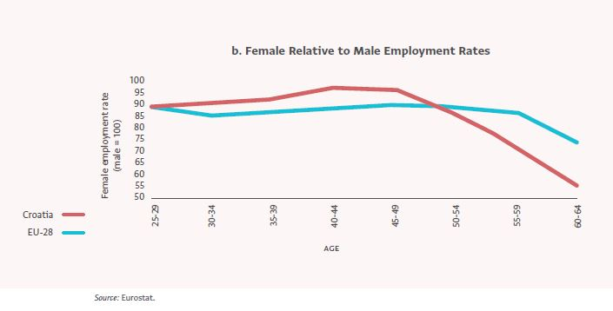
Signicifant gender gap in employment, especially after age 45
Only 61% of active (ages 25–64 years) women are employed, as opposed to 71% of active men.
In Croatia, after age 45 employment rates of women relative to men drop much faster than in the rest of the EU.

Slide 3
Investment in child and elder care services is a must
Inactive population aged 26-64 not seeking employment due to caring responsibilities, by gender, 2017
Children in formal childcare, by age, 2017
Notes:
For women, the reproductive years are a particularly vulnerable time. When we discuss re-skilling these women, addressing their obligations and care-responsibilities is an important priority – and policy makers as well as firms have an important role to play in this context.
Investment in quality, accessible, and affordable child and elder care services is a must in order to alleviate pressure on families. In Croatia, formal childcare coverage for children under age 3 is the seventh lowest among the EU-28, and the lowest in the EU-28 for children ages 3 to school age, at 51 percent, far below the EU-28 average of 86 percent.
Workplaces should strive to become more flexible and support part-time arrangements. Part-time employment is a more attractive option for women aiming to reconcile their wish or need to work while still being able to tend to the tasks they traditionally undertake, such as looking after their children. Part-time employment for Croatian women, at 5.8 percent, is far below the EU-28 average of 30.9 percent.
Let me share an encouraging example from Japan in this context. In Japan, two-thirds of women leave the workforce permanently after having a baby, due to reasons such as long working hours, cultural factors, and insufficient childcare options. Google who was affected by the drop out of female staff started the Happy Back to Work program. It invited people from all over Japan to share ideas on how to make it easier for women to return to work. Over 5000 ideas were collected and shared with more than 1,000 partner companies. Changes that were prompted by this initiative included changing policies around bringing children to work when they’re sick and can’t go to daycare, offering free babysitting, becoming more flexible with work hours, and using training to change co-workers’ attitudes and perceptions toward working mothers. In addition, Google developed re-skilling modules for women, that leveraged online options, teleworking and digital skills acquisition.

Slide 4
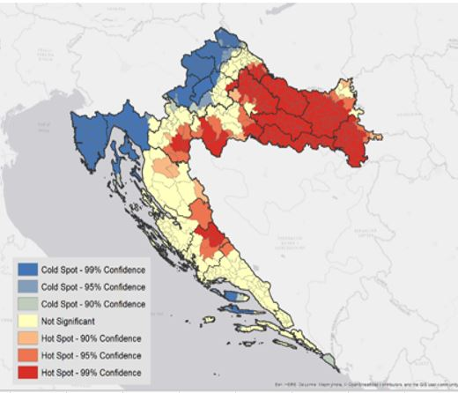
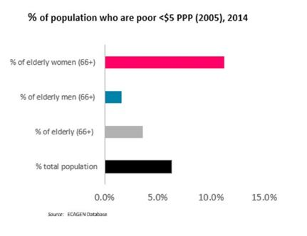
POVERTY OF Women IS STRONGLY DETERMINED by LOCATION And AGE
Rural areas remain far behind urban areas in terms of poverty, employment, education, access to services, child and elder care.
The at-risk-of-poverty rate for those over 65 is 29.5% for women, and 21.9% for men.
Notes:
Data from Croatia to illustrate the point

Slide 5
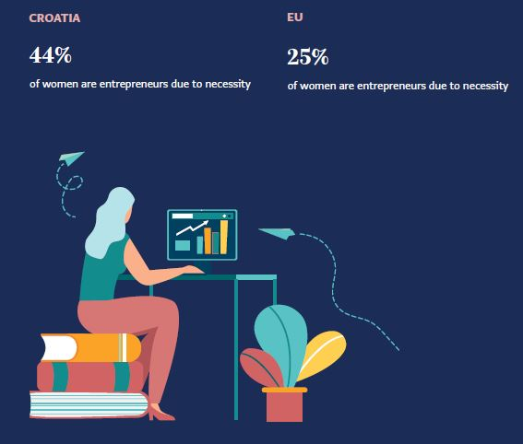
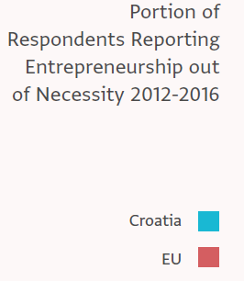
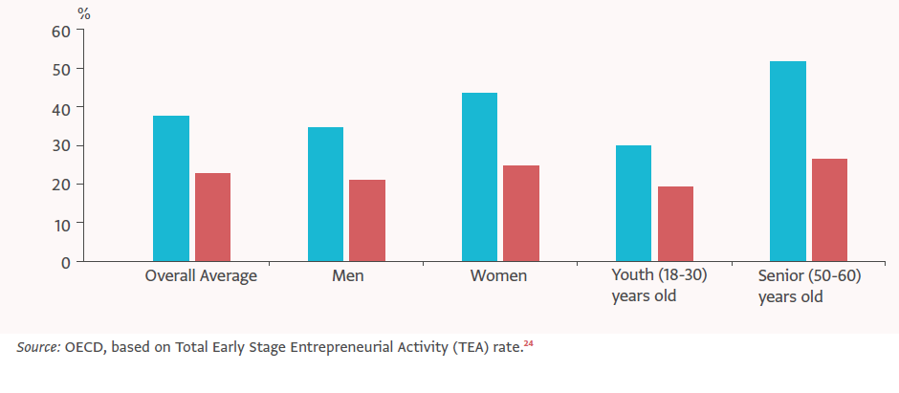
Women entrepreneurship is often a matter of necessity
In Croatia, more than half (51.5%) of senior entrepreneurs choose entrepreneurship out of necessity (as compared to 21% in the EU).
Notes:
Hard-to reach population groups often resort to self-employment due to a lack of formal employment
opportunities. Women, older men, and youth are more likely to resort to entrepreneurship
When women resort to entrepreneurship, they are handicapped by the lack of financial literacy
and business-related skills or support needed to succeed in the marketplace. There is
an absence of effective and affordable business development services that could empower women
to take on entrepreneurial roles and start and continue in businesses. A supporting ecosystem of
structured and continuous support is needed in the form of business development from incubation
to development to expansion.

Slide 6
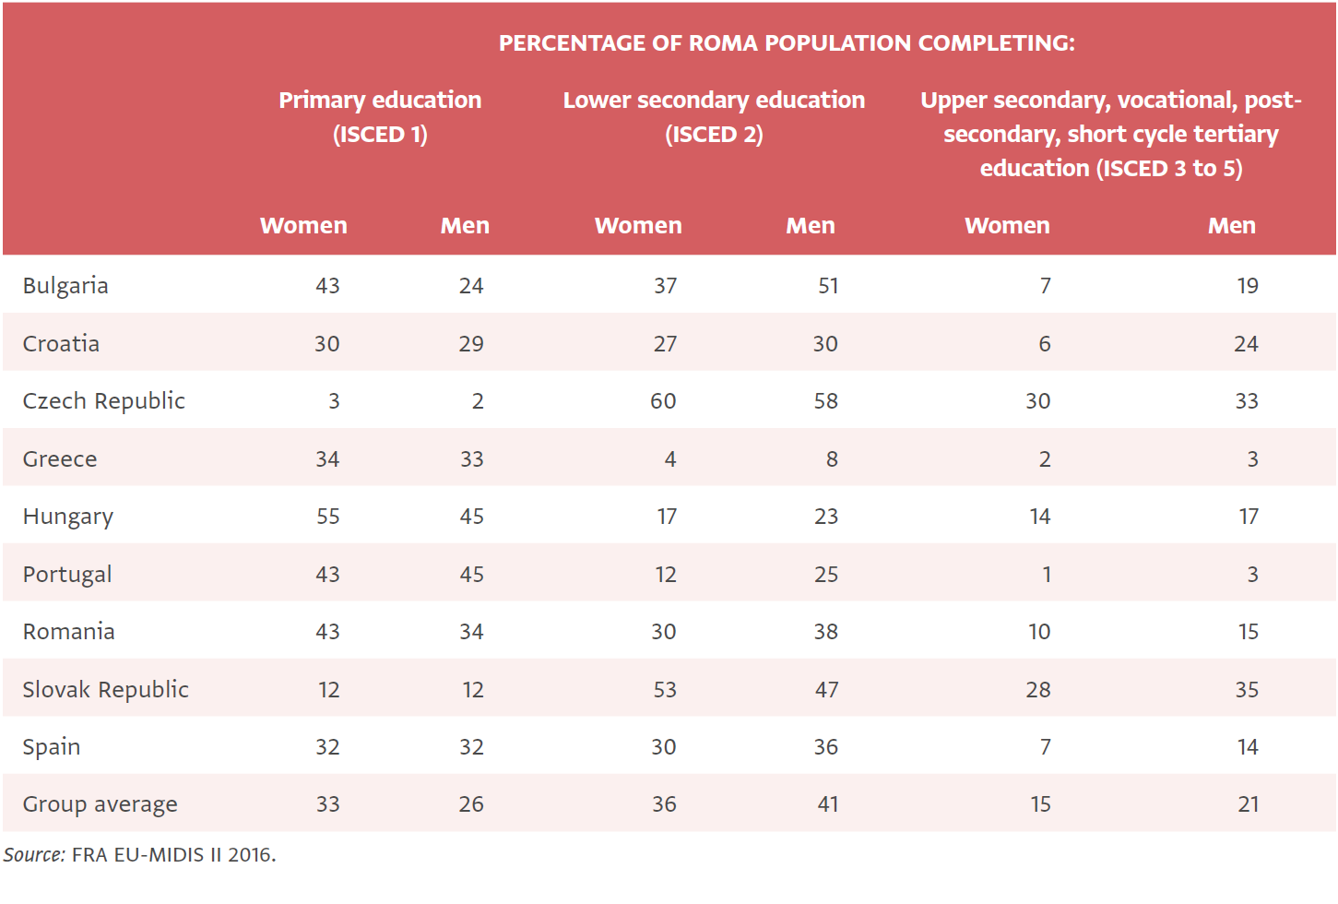
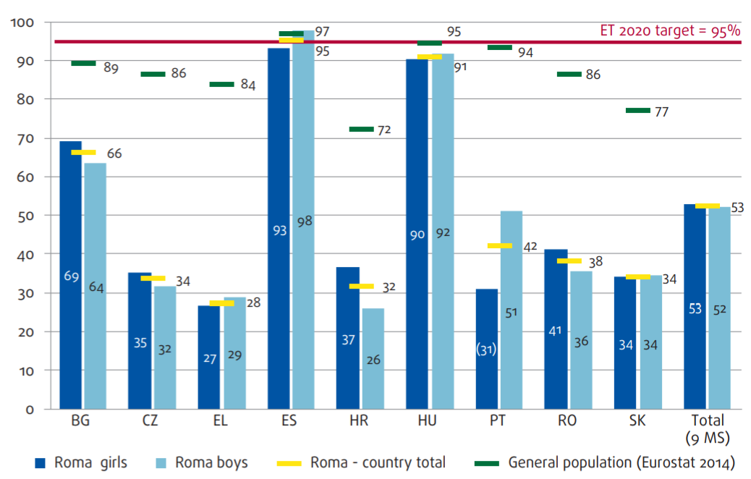
Difficulties in Skills Acquirement for Girls from Disadvantaged Backgrounds Start Early and Increase over the Lifecycle
Children aged between 4 years and the (country-specific) starting age of compulsory education who participate in early childhood education, by EU Member State (%)
Notes:
Early childhood education and development is an important determinant of future life opportunities.
Rates of Roma women not in education, employment or training (NEETS) are strikingly high in Europe
They also do not accumulate human capital through formal channels of education, training,
or employment (Eurofound 2014). Youth who drop out before completing secondary school typically
lack key skills that formal sector employment requires. Often they end up settling for less stable
jobs in the informal sector, which sets them on a lifetime path of lower earnings and opportunities.
In addition, there is a long-term effect on labor markets: generations that have higher shares of
NEETs experience long-lasting loss of productivity, lowering overall economic growth (International
Labour Organization (ILO) 2013, Eurofound 2014). The phenomenon may also contribute to crime,
addiction, disruptive behavior, and social disintegration (World Bank 2012). Given that most NEET
youth come from poor households, the trend will also lead to greater intergenerational poverty and
obstruct social mobility (Mauro and Mitra 2015; World Bank 2012).

